Slide 1
18CSC201J DATA STRUCTURES AND ALGORITHMS
UNIT 1

Slide 2
Topics to be covered
S1 : Introduction – Basic Terminology - Data Structures
S2 : Data Structure Operations - ADT
S3 : Algorithms – Searching Techniques – Complexity – Time, Space Matrix
S4 : Algorithms – Sorting - Complexity – Time, Space Matrix
S5 : Mathematical notations – Asymptotic notations – Big O, Omega
S6 : Asymptotic notations – Theta – Mathematical functions
S7 : Data Structures and its Types - Linear and Non Linear Data Structures
S8 : 1D, 2D Array Initialization using Pointers - 1D, 2D Array Accessing using Pointers
S9 : Declaring Structure and accessing – Declaring Arrays of Structures and accessing

Slide 3
INTRODUCTION BASIC TERMINOLOGY

Slide 4
Introduction
Data Structure can be defined as the group of data elements which provides an efficient way of storing and organizing data in the computer so that it can be used efficiently.
Some examples of Data Structures are arrays, Linked List, Stack, Queue, etc.
Data Structures are widely used in almost every aspect of Computer Science i.e. Operating System, Compiler Design, Artificial intelligence, Graphics and many more.

Slide 5
Basic Terminology
Data are values or sets of values
A data item refers to a single unit of values. Data items are divided into subitems are called group items.
For example, an employee’s name may be divided into three subitems first name, middle name and last name but the social security number would treated as a single name.
Collections of data are organized into a hierarchy of fields, records and files.

Slide 6
Basic Terminology (Cont..)
Record can be defined as the collection of various data items.
For example, if we talk about the student entity, then its name, address, course and marks can be grouped together to form the record for the student.
Record is classified according to length. A file can have fixed length records or variable length records.
In fixed length records, all the records contain the same data items with the same amount of space assigned to each data items.
In variable length records, file records may contain different lengths. Variable length records have a minimum and a maximum length.
For example, student records have variable length, since different students take different numbers of courses

Slide 7
Basic Terminology (Cont..)
A File is a collection of various records of one type of entity.
For example, if there are 60 employees in the class, then there will be 20 records in the related file where each record contains the data about each employee.
An entity represents the class of certain objects. It contains various attributes. Each attribute represents the particular property of that entity.
For example, consider an employee of an organization:
Attributes: Name Age Sex Social Security Number
Values: JOHN 34 M 134-24-5533
Field is a single elementary unit of information representing the attribute of an entity.

Slide 8
Basic Terminology – Example
A professor keeps a class list containing the following data for each student:
Name, Major, Student Number, Test Scores, Final Grades
State the entities, attributes and entity set of the list.
Describe the field values, records and file.
Which attribute can serve as primary keys for the list?
a) Each student is an entity, and the collection of students is the entity set. The properties, name, major, and so on. of the students are the attributes.
b) The field values are the values assigned to the attributes, i. e., the actual names, test scores, and so on. The field values for each student constitute a record, and the collection of all the student records is the file.
c) Either Name or Student Number can serve as a primary key, since each uniquely determines the student’s record. Normally the professor uses Name as the primary key, but the registrar may use students Number.

Slide 9
DATA STUCTURES

Slide 10
Data Structures
Data Structure can be defined as the group of data elements which provides an efficient way of storing and organizing data in the computer so that it can be used efficiently.
Data Structures are the main part of many computer science algorithms as they enable the programmers to handle the data in an efficient way.
It plays a vital role in enhancing the performance of a software or a program as the main function of the software is to store and retrieve the user's data as fast as possible.

Slide 11
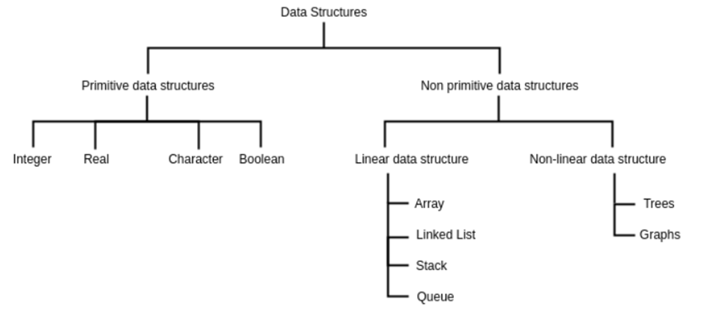
Classification of Data Structures

Slide 12
Primitive & Non-Primitive of Data Structures
Primitive data structures are the fundamental data types which are supported by a programming language.
Some basic data types are integer, real(float), character, and Boolean.
Non-primitive data structures are data structures which are created using primitive data structures.
Examples of such data structures include linked lists, stacks, trees, and graphs.
Non-primitive data structures can further be classified into two categories: linear and non-linear data structures.

Slide 13
Linear Data Structures
If the elements of a data structure are stored in a linear or sequential order, then it is a linear data structure.
Examples include arrays, linked lists, stacks, and queues.
Linear data structures can be represented in memory in two different ways.
One way is to have a linear relationship between elements by means of sequential memory locations.
The other way is to have a linear relationship between elements by means of links.

Slide 14
Non Linear Data Structures
If the elements of a data structure are not stored in a sequential order, then it is a non-linear data structure.
The relationship of adjacency is not maintained between elements of a non-linear data structure.
Examples include trees and graphs.

Slide 15
Review Questions
A hospital maintains a patient file in which each record contains the following data:
Name, Admission date, Social security number, Room, Bed number, Doctor
Which items can serve as primary keys?
Which pair of items can serve as a primary key?
Which items can be group items?
Which of the following data items may lead to variable length records when included as items in the record:
(a) age, (b) sex, (c) name of spouse, (d) names of children, (e) education,
(f) previous employers

Slide 16
DATA STUCTURE OPERATIONS

Slide 17
Data Structure Operations
The data in the data structures are processed by certain operations.
Traversing
Searching
Inserting
Updating
Deleting
Sorting
Merging

Slide 18
Data Structure Operations (Cont..)
Traversing - Visiting each record so that items in the records can be accessed.
Searching - Finding the location of the record with a given key or value or finding all records which satisfy given conditions.
Inserting - Adding a new record to the data structure.
Updating – Change the content of some elements of the record.
Deleting - Removing records from the data structure.
Sorting - Arranging records in some logical or numerical order.
(Eg: Alphabetic order)
Merging - Combining records from two different sorted files into a single file.

Slide 19
Example
An organization contains a membership file in which each record contains the following data for a given member:
Name, Address, Telephone Number, Age, Sex
Suppose the organization wants to announce a meeting through a mailing. Then one would traverse the file to obtain Name and Address of each member.
Suppose one wants to find the names of all members living in a particular area. Again traverse and search the file to obtain the data.
Suppose one wants to obtain Address of a specific Person. Then one would search the file for the record containing Name.
Suppose a member dies. Then one would delete his or her record from the file.

Slide 20
Example
Suppose a new person joins the organization. Then one would insert a record into the file
Suppose a member has shifted to a new residence his/her address and telephone number need to be changed. Given the name of the member, one would first need to search for the record in the file. Then perform the update operation, i.e. change some items in the record with the new data.
Suppose one wants to find the number of members whose age is 65 or above. Again one would traverse the file, counting such members.

Slide 21
ABSTRACT DATA TYPE

Slide 22
Abstract Data Types
An Abstract Data type (ADT) is a type for objects whose behavior is defined by a set of value and a set of operations.
ADT refers to a set of data values and associated operations that are specified accurately, independent of any particular implementation.
The ADT consists of a set of definitions that allow us to use the functions while hiding the implementation.
Abstract in the context of data structures means everything except the detailed specifications or implementation.
Data type of a variable is the set of values that the variable can take.
Examples: Stacks, Queues, Linked List
ADT = Type + Function Names + Behaviour of each function

Slide 23
ADT Operations
While modeling the problems the necessary details are separated out from the unnecessary details. This process of modeling the problem is called abstraction.
The model defines an abstract view to the problem. It focuses only on problem related stuff and that you try to define properties of the problem.
These properties include
The data which are affected.
The operations which are identified.

Slide 24
ADT Operations ( Cont..)
Abstract data type operations are
Create - Create the data structure.
Display - Displaying all the elements stored in the data structure.
Insert - Elements can be inserted at any desired position.
Delete - Desired element can be deleted from the data structure.
Modify - Any desired element can be deleted/modified from the data structure.

Slide 25
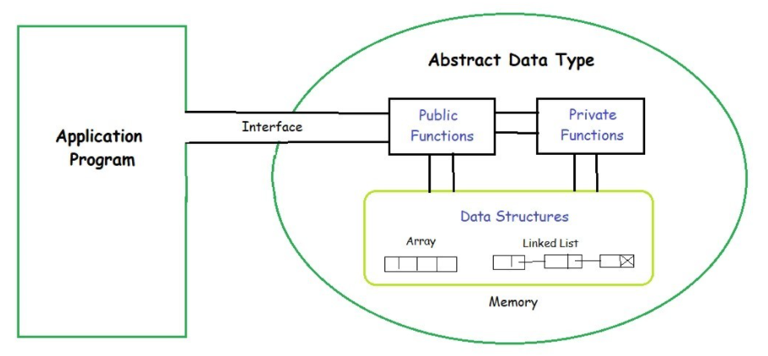
Abstract Data Types Model
The ADT model has two different parts functions (public and private) and data structures.
Both are contained within the ADT model itself, and do not come within the scope of the application program.
Data structures are available to all of the ADT’s functions as required, and a function may call any other function to accomplish its task.
Data structures and functions are within the scope of each other.

Slide 26
Abstract Data Types Model (Cont..)
Data are entered, accessed, modified and deleted through the external application programming interface.
For each ADT operation, there is an algorithm that performs its specific task.
The operation name and parameters are available to the application, and they provide only an interface to the application.
When a list is controlled entirely by the program, it is implemented using simple structure.

Slide 27
Review Questions
______ are used to manipulate the data contained in various data structures.
In ______, the elements of a data structure are stored sequentially.
______ of a variable specifies the set of values that the variable can take.
Abstract means ______.
If the elements of a data structure are stored sequentially, then it is a ______.
External API (operations on data)
Linear Data Structure
Domain
Hiding Implementation
Linear Data Structure

Slide 28
ALGORITHMS SEARCHING TECHIQUES

Slide 29
Algorithms
An algorithm is a well defined list of steps for solving a particular problem.
The time and space are two major measures of the efficiency of an algorithm.
The complexity of an algorithm is the function which gives the running time and / or space in terms of input size.

Slide 30
Searching Algorithms
Searching Algorithms are designed to check for an element or retrieve an element from any data structure where it is stored.
Based on the type of search operation, these algorithms are generally classified into two categories:
Linear Search
Binary Search

Slide 31
Linear Search
Linear search is a very basic and simple search algorithm.
In Linear search, we search an element or value in a given array by traversing the array from the starting, till the desired element or value is found or we can establish that the element is not present.
It compares the element to be searched with all the elements present in the array and when the element is matched successfully, it returns the index of the element in the array, else it return -1.
Linear search is applied on unsorted or unordered lists, when there are fewer elements in a list.

Slide 32
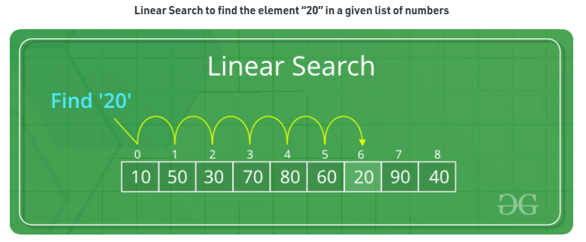
Linear Search - Example
Search each record of the file, one at a time, until finding the given value.

Slide 33
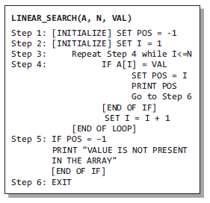
Algorithm for Linear Search
In Steps 1 and 2 of the algorithm, we initialize the value of POS and I.
In Step 3, a while loop is executed that would be executed till I is less than N.
In Step 4, a check is made to see if a match is found between the current array element and VAL.
If a match is found, then the position of the array element is printed, else the value of I is incremented to match the next element with VAL.
If all the array elements have been compared with VAL and no match is found, then it means that VAL is not present in the array.

Slide 34
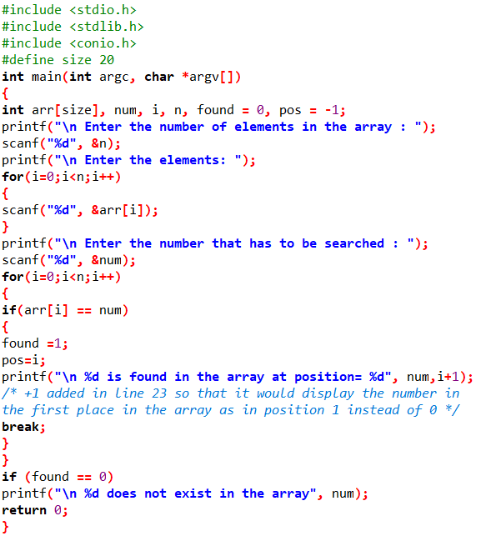
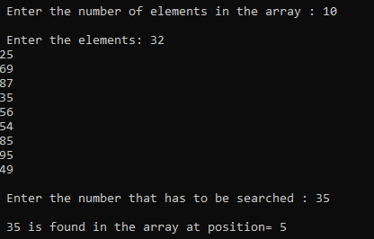
Program for Linear Search

Slide 35
Linear Search - Advantages
When a key element matches the first element in the array, then linear search algorithm is best case because execution time of linear search algorithm is O(n), where n is the number of elements in an array.
The list doesn’t have to sort. Contrary to a binary search, linear searching does not demand a structured list.
Not influenced by the order of insertions and deletions. Since the linear search doesn’t call for the list to be sorted, added elements can be inserted and deleted.

Slide 36
Linear Search - Disadvantages
The drawback of a linear search is the fact that it is time consuming if the size of data is huge.
Every time a vital element matches the last element from the array or an essential element does not match any element Linear search algorithm is the worst case.

Slide 37
Binary Search
Binary Search is used with sorted array or list. In binary search, we follow the following steps:
We start by comparing the element to be searched with the element in the middle of the list/array.
If we get a match, we return the index of the middle element and terminate the process
If the element/number to be searched is greater than the middle element, we pick the elements on the left/right side of the middle element, and move to step 1.
If the element/number to be searched is lesser in value than the middle number, then we pick the elements on the right/left side of the middle element, and move to step 1.

Slide 38
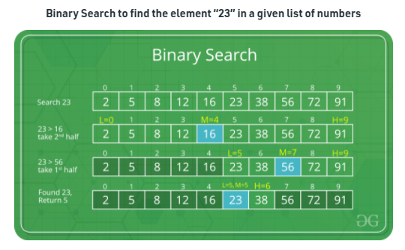
Binary Search - Example
Binary Search is useful when there are large number of elements in an array and they are sorted.

Slide 39
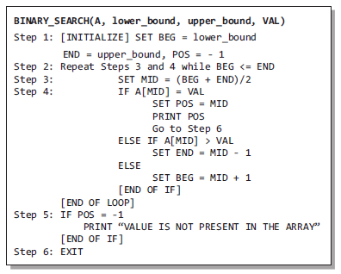
Algorithm for Binary Search
In Step 1, we initialize the value of variables, BEG, END, and POS.
In Step 2, a while loop is executed until BEG is less than or equal to END.
In Step 3, the value of MID is calculated.
In Step 4, we check if the array value at MID is equal to VAL. If a match is found, then the value of POS is printed and the algorithm exits. If a match is not found, and if the value of A[MID] is greater than VAL, the value of END is modified, otherwise if A[MID] is greater than VAL, then the value of BEG is altered.
In Step 5, if the value of POS = –1, then VAL is not present in the array and an appropriate message is printed on the screen before the algorithm exits.

Slide 40
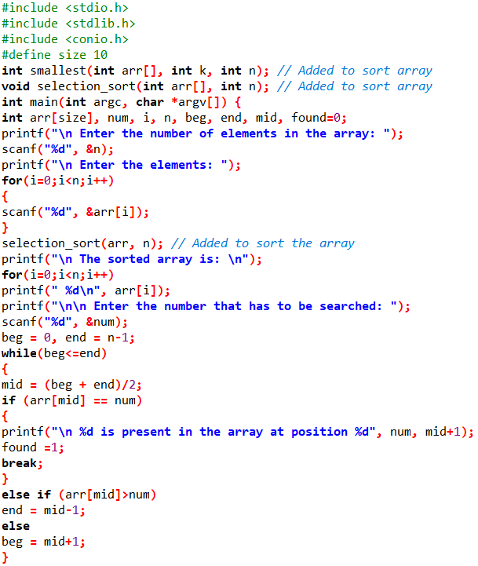
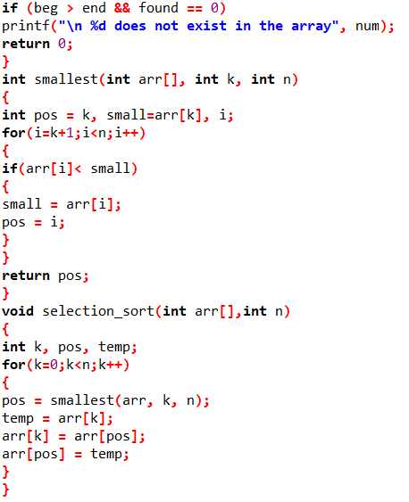
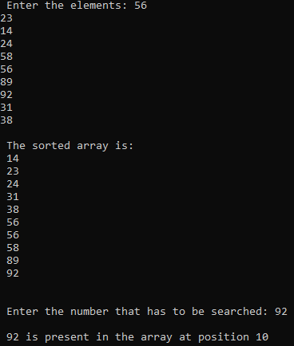
Program for Binary Search

Slide 41
Binary Search (Cont..)
Advantages
Disadvantages
It eliminates half of the list from further searching by using the result of each comparison.
It indicates whether the element being searched is before or after the current position in the list.
This information is used to narrow the search.
For large lists of data, it works significantly better than linear search.
It employs recursive approach which requires more stack space.
Programming binary search algorithm is error prone and difficult.
The interaction of binary search with memory hierarchy i.e. caching is poor.

Slide 42
Difference between Linear & Binary Search
Linear Search
Binary Search
Linear Search necessitates the input information to be not sorted
Linear Search needs equality comparisons.
Linear search has complexity C(n)= n/2.
Linear Search needs sequential access.
Binary Search necessitates the input information to be sorted.
Binary Search necessitates an ordering contrast.
Binary Search has complexity C(n)= log ₂ n.
Binary Search requires random access to this information.

Slide 43
COMPLEXITY TIME, SPACE MATRIX

Slide 44
Linear Search – Time & Space Matrix
Time Complexity
We need to go from the first element to the last so, in the worst case we have to iterate through ‘n’ elements, n being the size of a given array.
Space Complexity
We don't need any extra space to store anything.
We just compare the given value with the elements in an array one by one.
Time Complexity is O(n)
Space Complexity is O(1)

Slide 45
Binary Search – Time & Space Matrix
Time Complexity
We start from the middle of the array and keep dividing the search area by half.
In other words, search interval decreases in the power of 2 (2048, 1024, 512, ..).
Space Complexity
We just need to store three values: `lower_bound`, `upper_bound`, and `middle_position`.
Time Complexity is O(Log n)
Space Complexity is O(1)

Slide 46
Review Questions
The worst case complexity is ______ when compared with the average case complexity of a binary search algorithm.
(a) Equal (b) Greater (c) Less (d) None of these
The complexity of binary search algorithm is
(a) O(n) (b) O(n2) (c) O(n log n) (d) O(log n)
Which of the following cases occurs when searching an array using linear search the value to be searched is equal to the first element of the array?
(a) Worst case (b) Average case (c) Best case (d) Amortized case
Performance of the linear search algorithm can be improved by using a ______.
The complexity of linear search algorithm is ______.

Slide 47
ALGORITHM SORTING

Slide 48
SORTING
Sorting is a technique to rearrange the elements of a list in ascending or descending order, which can be numerical, lexicographical, or any user-defined order.
Sorting is a process through which the data is arranged in ascending or descending order.
Sorting can be classified in two types;
Internal Sorts
External Sorts

Slide 49
SORTING - INTERNAL SORTS
Internal Sorts:- This method uses only the primary memory during sorting process. All data items are held in main memory and no secondary memory is required for this sorting process.
If all the data that is to be sorted can be accommodated at a time in memory is called internal sorting. There is a limitation for internal sorts; they can only process relatively small lists due to memory constraints. There are 3 types of internal sorts based on the type of process used while sorting.
(i) SELECTION :- Ex:- Selection sort algorithm, Heap Sort algorithm
(ii) INSERTION :- Ex:- Insertion sort algorithm, Shell Sort algorithm
(iii) EXCHANGE :- Ex:- Bubble Sort Algorithm, Quick sort algorithm

Slide 50
SORTING – EXTERNAL SORTS
External Sorts:- Sorting large amount of data requires external or secondary memory. This process uses external memory such as HDD, to store the data which is not fit into the main memory. So, primary memory holds the currently being sorted data only.
All external sorts are based on process of merging. Different parts of data are sorted separately and merged together. Ex:- Merge Sort

Slide 51
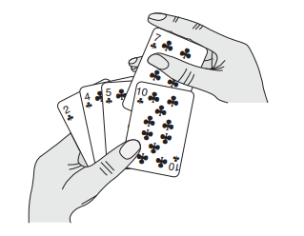
INSERTION SORT
Insertion Sort Algorithm sorts array by shifting elements one by one and inserting the right element at the right position
It works similar to the way you sort playing cards in your hands

Slide 52
INSERTION SORT
Insertion sorts works by taking elements from the list one by one and inserting them in their current position into a new sorted list.
Insertion sort consists of N - 1 passes, where N is the number of elements to be sorted.
The ith pass of insertion sort will insert the ith element A[i] into its rightful place among A[1], A[2] to A[i - 1]. After doing this insertion the records occupying A[1]....A[i] are in sorted order.
Pseudo code
INSERTION-SORT(A)
for i = 1 to n
key ← A [i]
j ← i – 1
while j > = 0 and A[j] > key
A[j+1] ← A[j]
j ← j – 1
End while
A[j+1] ← key
End for

Slide 53
Working of insertion sort – Ascending order
We start by considering the second element of the given array, i.e. element at index 1, as the key.
We compare the key element with the element(s) before it, i.e., element at index 0:
If the key element i.e index 1 is less than the first element, we insert the key element before the first element.(swap)
If the key element is greater than the first element, then we insert it remains at its position
Then, we make the third element of the array as key and will compare it with elements to it's left and insert it at the right position.
And we go on repeating this, until the array is sorted
.

Slide 54
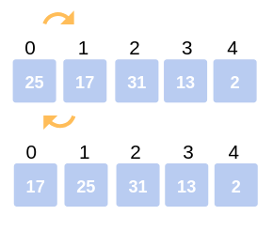
Example
Let us now understand working with the following example:
Consider the following array: 25, 17, 31, 13, 2 where N=5
First Iteration: Compare 17 with 25. The comparison shows 17< 25. Hence swap 17 and 25.
The array now looks like:
17, 25, 31, 13, 2

Slide 55
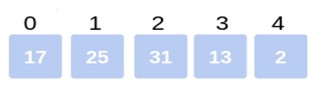

EXAMPLE (Cont..)
Second Iteration:.
Now hold on to the third element (31) and compare with the ones preceding it.
Since 31> 25, no swapping takes place.
Also, 31> 17, no swapping takes place and 31 remains at its position.
The array after the Second iteration looks like:
17, 25, 31, 13, 2

Slide 56
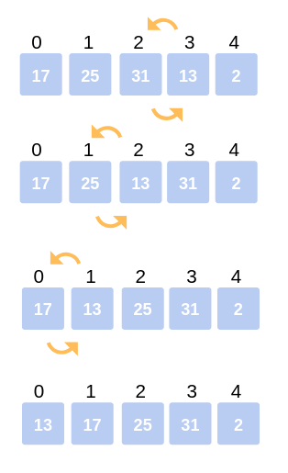
EXAMPLE (Cont..)
Third Iteration: Start the following Iteration with the fourth element (13), and compare it with its preceding elements.
Since 13< 31, we swap the two.
Array now becomes: 17, 25, 13, 31, 2.
But there still exist elements that we haven’t yet compared with 13. Now the comparison takes place between 25 and 13. Since, 13 < 25, we swap the two.
The array becomes 17, 13, 25, 31, 2.
The last comparison for the iteration is now between 17 and 13. Since 13 < 17, we swap the two.
The array now becomes 13, 17, 25, 31, 2.

Slide 57
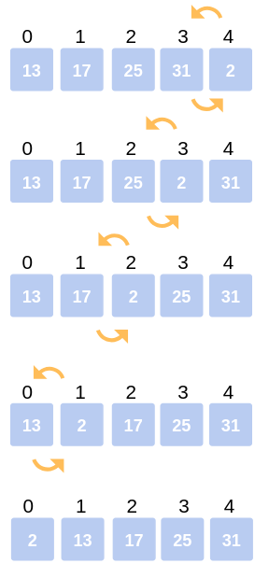
EXAMPLE (Cont..)
Fourth Iteration: The last iteration calls for the comparison of the last element (2), with all the preceding elements and make the appropriate swapping between elements.
Since, 2< 31. Swap 2 and 31.
Array now becomes: 13, 17, 25, 2, 31.
Compare 2 with 25, 17, 13.
Since, 2< 25. Swap 25 and 2.
13, 17, 2, 25, 31.
Compare 2 with 17 and 13.
Since, 2<17. Swap 2 and 17.
Array now becomes:
13, 2, 17, 25, 31.
The last comparison for the Iteration is to compare 2 with 13.
Since 2< 13. Swap 2 and 13.
The array now becomes:
2, 13, 17, 25, 31.
This is the final array after all the corresponding iterations and swapping of elements.
Insertion sort consists of N - 1 passes
Where N=5 So 5-1=4
Number of pass=4(4th iteration all the elements are sorted)

Slide 58
Advantages & Disadvantages
Advantages
The main advantage of the insertion sort is its simplicity
It also exhibits a good performance when dealing with a small list.
The insertion sort is an in-place sorting algorithm so the space requirement is minimal
Disadvantages
The disadvantage of the insertion sort is that it does not perform when compared to few other, sorting algorithms
With n-squared steps required for every n element to be sorted, the insertion sort does not deal well with a huge list.
The insertion sort is particularly useful only when sorting a list of few items

Slide 59
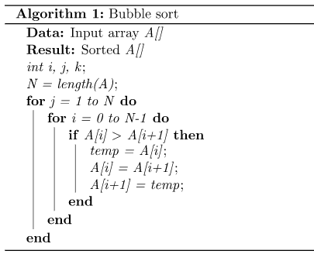
BUBBLE SORT
The movement of air bubbles in the water that rise up to the surface, each element of the array move to the end in each iteration. Therefore, it is called a bubble sort.
Bubble sort is a simple sorting algorithm. This sorting algorithm is comparison-based algorithm in which each pair of adjacent elements is compared and the elements are swapped if they are not in order
Steps to implement bubble sort:
Assume that there are n elements in the list
In first cycle,
Start by comparing 1st and 2nd element and swap if they are not in order.
After that do the same for 2nd and 3rd element. Repeat till n-1th and n^{th} elements are compared.
At the end of cycle one element (max/min) will be placed as the last element in of list.
The process specified in step 1 is repeated for another n-2 times, where in each time the number of comparisons reduce by 1 as the list of sorted elements grow.

Slide 60
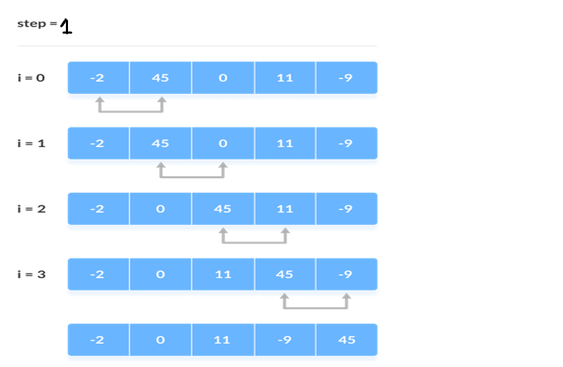
Working of Bubble Sort – Ascending order
Suppose we are trying to sort the elements in ascending order.
Let us now understand working with the following example:
Consider the following array: -2,45,0,11,-9 where N=5
First Iteration (Compare and Swap)
Starting from the first index, compare the first and the second elements.
If the first element is greater than the second element, they are swapped.
Now, compare the second and the third elements. Swap them if they are not in order.
The above process goes on until the last element

Slide 61
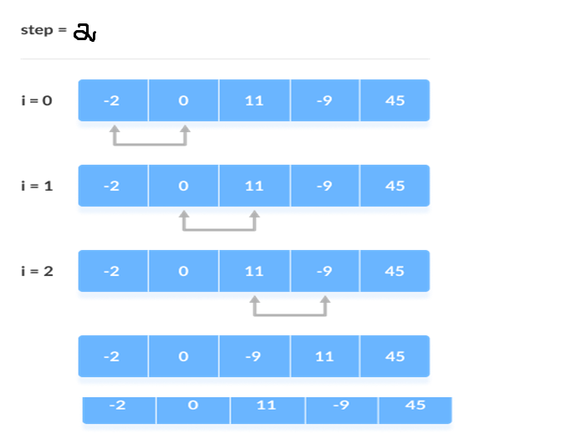
Working of Bubble Sort (Cont..)
Second Iteration
The same process goes on for the remaining iterations.
After each iteration, the largest element among the unsorted elements is placed at the end.
Put the largest element at the end

Slide 62
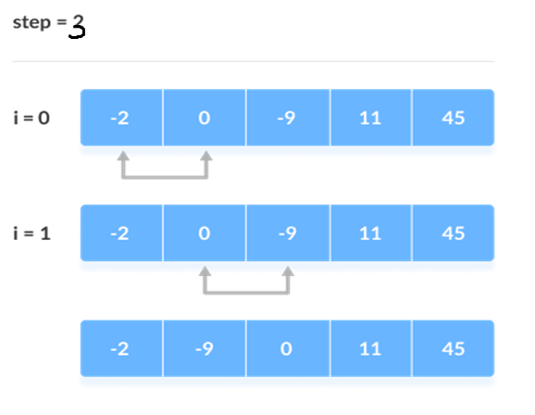
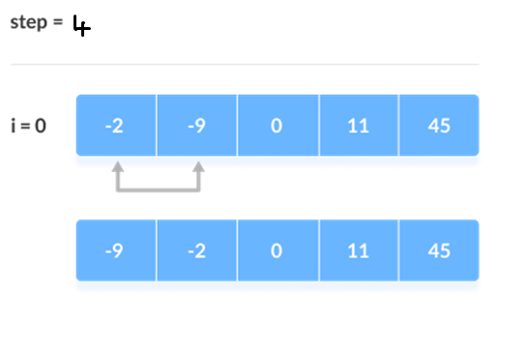
Working of Bubble Sort (Cont..)
Third Iteration
In each iteration, the comparison takes place up to the last unsorted element.
Fourth Iteration
The array is sorted when all the unsorted elements are placed at their correct positions.
The array is sorted if all elements are kept in the right order. Now all the elements are sorted
Compare the adjacent elements

Slide 63
ADVANTAGES AND DISADVANTAGES
Advantage:
It is the simplest sorting approach.
The primary advantage of the bubble sort is that it is popular and easy to implement.
In the bubble sort, elements are swapped in place without using additional temporary storage. Stable sort: does not change the relative order of elements with equal keys.
The space requirement is at a minimum
Disadvantage:
Bubble sort is comparatively slower algorithm.
The main disadvantage of the bubble sort is the fact that it does not deal well with a list containing a huge number of items.
The bubble sort requires n-squared processing steps for every n number of elements to be sorted.

Slide 64
COMPLEXITY – TIME , SPACE TRADE OFF

Slide 65
SPACE COMPLEXITY
Space complexity is the total amount of memory space used by an algorithm/program including the space of input values for execution. So to find space-complexity, it is enough to calculate the space occupied by the variables used in an algorithm/program.
Space complexity S(P) of any algorithm P is,
S(P) = C + SP(I)
Where C is the fixed part and S(I) is the variable part of the algorithm which depends on instance characteristic I.
Example:
Algorithm: SUM(A, B)
Step 1 - START
Step 2 - C ← A + B + 10
Step 3 – Stop
Here we have three variables A, B & C and one constant. Hence S(P) = 1+3.
Space requirement depends on data types of given variables & constants. The number will be multiplied accordingly.

Slide 66
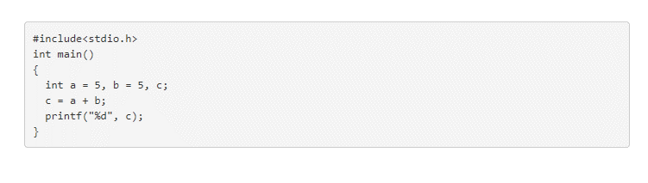
How to calculate Space Complexity of an Algorithm?
In the Example program, 3 integer variables are used.
The size of the integer data type is 2 or 4 bytes which depends on the architecture of the system (compiler). Let us assume the size as 4 bytes.
The total space required to store the data used in the example program is 4 * 3 = 12, Since no additional variables are used, no extra space is required. Hence, space complexity for the example program is O(1), or constant.

Slide 67
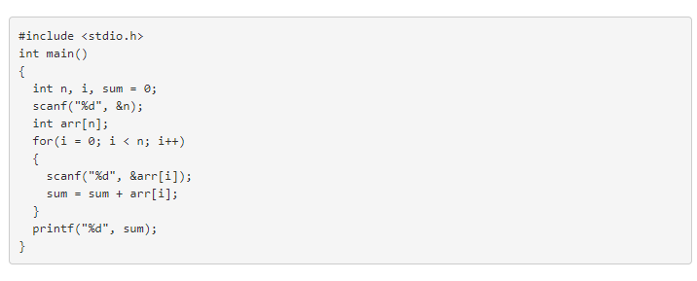
EXAMPLE 2
In the code given above, the array stores a maximum of n integer elements. Hence, the space occupied by the array is 4 * n. Also we have integer variables such as n, i and sum.
Assuming 4 bytes for each variable, the total space occupied by the program is 4n + 12 bytes.
Since the highest order of n in the equation 4n + 12 is n, so the space complexity is O(n) or linear.

Slide 68
EXAMPLE 3
#include<stdio.h>
int main()
{
int a = 5, b = 5, c;
c = a + b;
printf("%d", c);
}
Space Complexity: size(a)+size(b)+size(c)
=>let sizeof(int)=2 bytes=>2+2+2=6 bytes
=>O(1) or constant

Slide 69
Example 4
#include <stdio.h>
int main()
{
int n, i, sum = 0;
scanf("%d", &n);
int arr[n];
for(i = 0; i < n; i++)
{
scanf("%d", &arr[i]); sum = sum + arr[i];
}
printf("%d", sum);
}
Space Complexity:
The array consists of n integer elements.
So, the space occupied by the array is 4 * n. Also we have integer variables such as n, i and sum. Assuming 4 bytes for each variable, the total space occupied by the program is 4n + 12 bytes.
Since the highest order of n in the equation 4n + 12 is n, so the space complexity is O(n) or linear.

Slide 70
Time Complexity
Time Complexity of an algorithm represents the amount of time required by the algorithm to run to completion.
Time requirements can be defined as a numerical function T(n), where T(n) can be measured as the number of steps, provided each step consumes constant time.
Eg. Addition of two n-bit integers takes n steps.
Total computational time is T(n) = c*n,
where c is the time taken for addition of two bits.
Here, we observe that T(n) grows linearly as input size increases.

Slide 71

Time Complexity (Cont..)
Two methods to find the time complexity for an algorithm
Count variable method
Table method

Slide 72

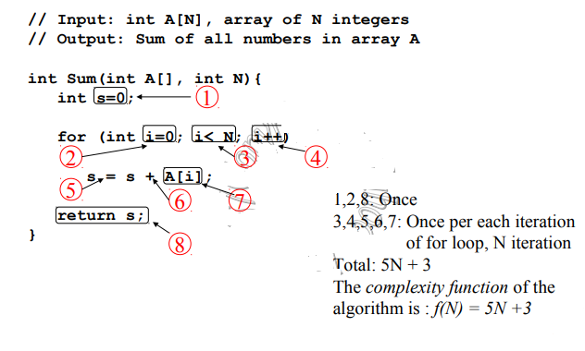
Count Variable Method

Slide 73
Table Method
The table contains s/e and frequency.
The s/e of a statement is the amount by which the count changes as a result of the execution of that statement.
Frequency is defined as the total number of times each statement is executed.
Combining these two, the step count for the entire algorithm is obtained.

Slide 74
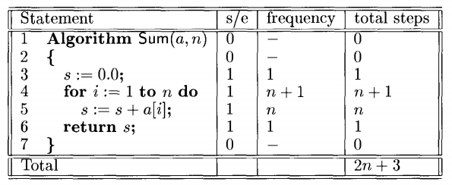
Example 1

Slide 75
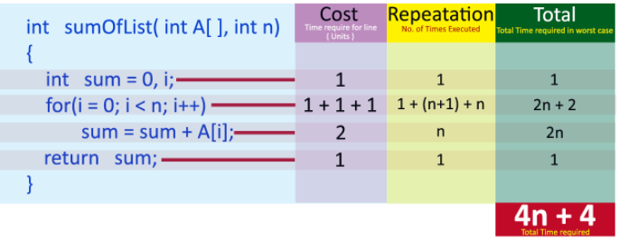
Example 2
int sum(int A[], int n)
{
int sum = 0, i;
for(i = 0; i < n; i++)
sum = sum + A[i];
return sum;
}
In above calculation Cost is the amount of computer time required for a single operation in each line.
Repetition is the amount of computer time required by each operation for all its repetitions.
Total is the amount of computer time required by each operation to execute. So above code requires '4n+4' Units of computer time to complete the task. Here the exact time is not fixed. And it changes based on the n value. If we increase the n value then the time required also increases linearly. Totally it takes '4n+4' units of time to complete its execution

Slide 76
Example 3
Consider the following piece of code...
int sum(int a, int b)
{
return a+b;
}
In the above sample code, it requires 1 unit of time to calculate a+b and 1 unit of time to return the value. That means, totally it takes 2 units of time to complete its execution. And it does not change based on the input values of a and b. That means for all input values, it requires the same amount of time i.e. 2 units.
If any program requires a fixed amount of time for all input values then its time complexity is said to be Constant Time Complexity

Slide 77
Example 4
 |  |  |  |  |  |  | Cost | Times
i = | 1; |  |  |  |  |  | c1 | 1
sum | = | 0; |  |  |  |  | c2 | 1
whil | e | (i | <= | n) |  | { | c3 | n+1
i = |  | i | + | 1; |  |  | c4 | n
sum |  | = | su | m | + | i; | c5 | n
}
3n+3
Total Cost = c1 + c2 + (n+1)*c3 + n*c4 + n*c5
The time required for this algorithm is proportional to n

Slide 78
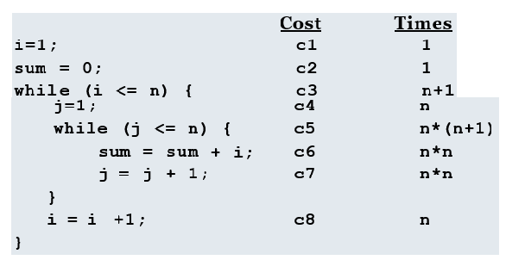
Example 5
Total Cost = c1 + c2 + (n+1)*c3 + n*c4 + n*(n+1)*c5+n*n*c6+n*n*c7+n*c8
The time required for this algorithm is proportional
to n²

Slide 79
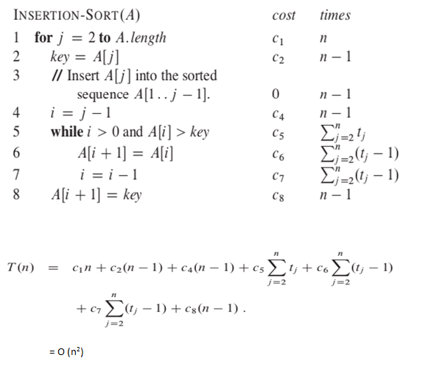
INSERTION SORT -TIME COMPLEXITY

Slide 80
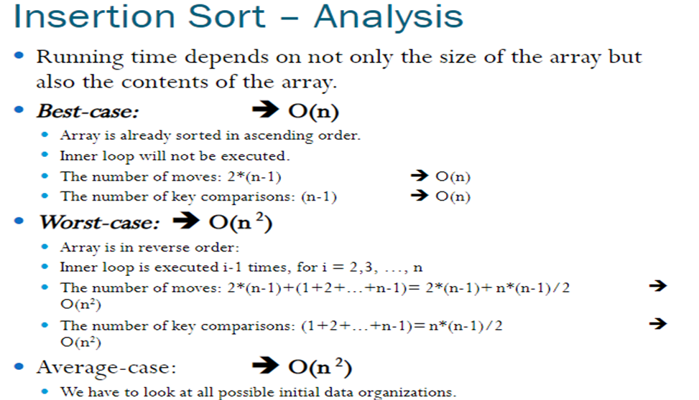

Slide 81
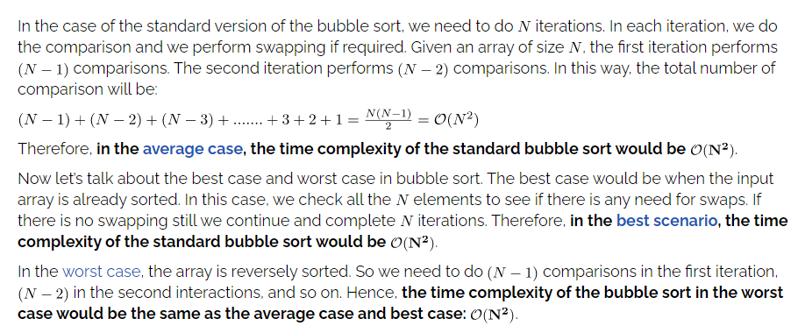
Time Complexity of Bubble Sort

Slide 82
Review Questions
Sort the following numbers using bubble sort and Insertion sort
35,12,14,9,15,45,32,95,40,5
3, 1, 4, 1, 5, 9, 2, 6, 5
17 14 34 26 38 7 28 32
35,12,14,9,15,45,32,95,40,5

Slide 83
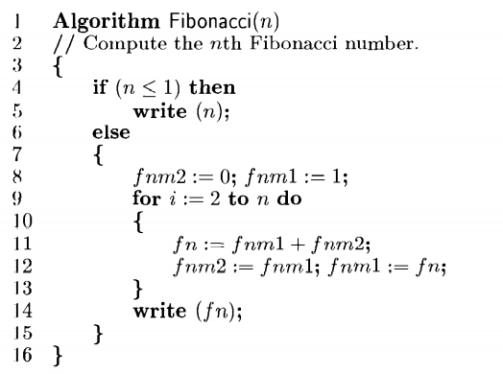
Review questions
1. Calculate the time complexity for the below algorithms using table method

Slide 84
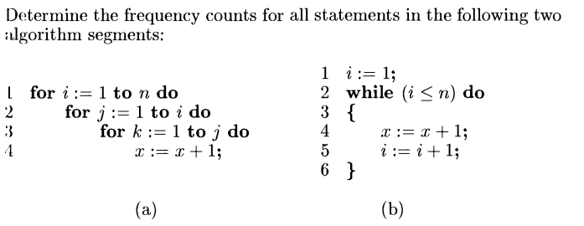
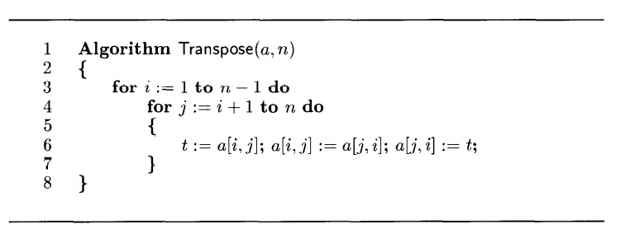
2.
3.

Slide 85
MATHEMATICAL NOTATIONS

Slide 86
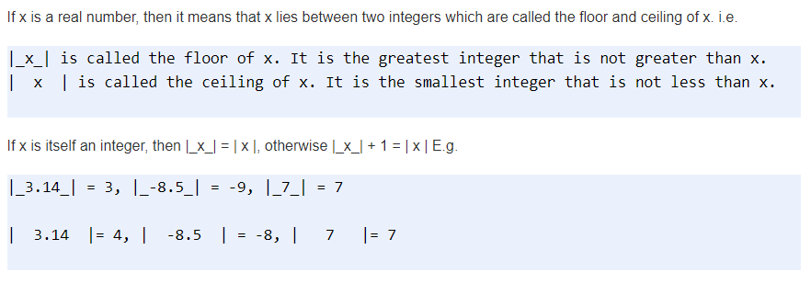
1. Floor and Ceiling Functions

Slide 87
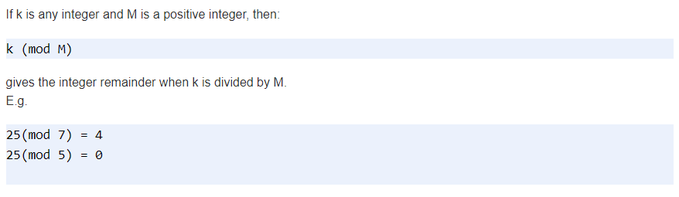
2. Remainder Function (Modular Arithmetic)

Slide 88
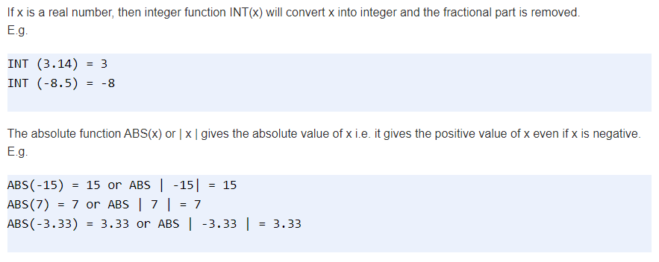
3. Integer and Absolute Value Functions

Slide 89
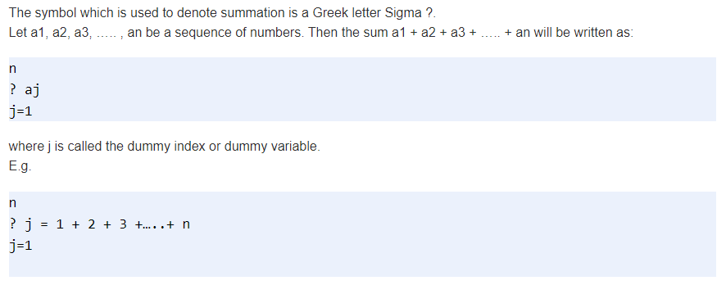
4. Summation Symbol (Sums)

Slide 90
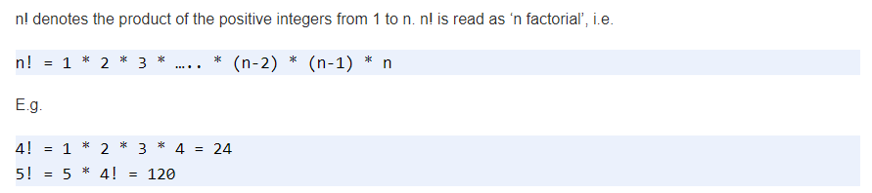
5. Factorial Function

Slide 91
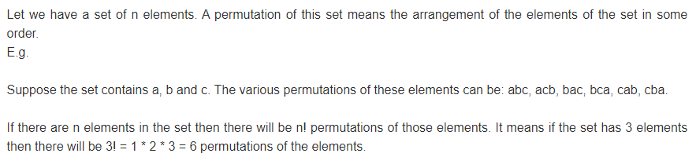
6. Permutations

Slide 92
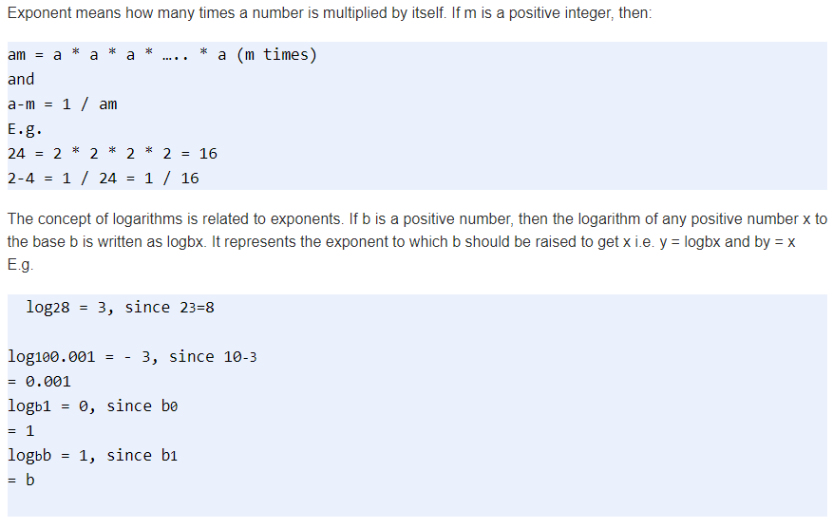
7. Exponents and Logarithms

Slide 93
ASYMPTOTIC NOTATIONS BIG O, OMEGA

Slide 94
Asymptotic Analysis
The time required by an algorithm falls under three types −
Best Case − Minimum time required for program execution.
Average Case − Average time required for program execution.
Worst Case − Maximum time required for program execution.

Slide 95
Asymptotic Analysis (Cont..)
Asymptotic analysis of an algorithm refers to defining the mathematical boundation/framing of its run-time performance.
Derive the best case, average case, and worst case scenario of an algorithm.
Asymptotic analysis is input bound.
Specify the behaviour of the algorithm when the input size increases
Theory of approximation.
Asymptote of a curve is a line that closely approximates a curve but does not touch the curve at any point of time.

Slide 96
Asymptotic notations
Asymptotic notations are mathematical tools to represent the time complexity of algorithms for asymptotic analysis.
Asymptotic order is concerned with how the running time of an algorithm increases with the size of the input, if input increases from small value to large values
1. Big-Oh notation (O)
2. Big-Omega notation (Ω)
3. Theta notation (θ)
4. Little-oh notation (o)
5. Little-omega notation (ω)

Slide 97
Big-Oh Notation (O)
Big-oh notation is used to define the worst-case running time of an algorithm and concerned with large values of n.
Definition: A function t(n) is said to be in O(g(n)), denoted as t(n) ϵ O(g(n)), if t(n) is bounded above by some constant multiple of g(n) for all large n. i.e., if there exist some positive constant c and some non-negative integer n0 such that
t(n) ≤ cg(n) for all n ≥ n0
O(g(n)): Class of functions t(n) that grow no faster than g(n).
Big-oh puts asymptotic upper bound on a function.

Slide 98
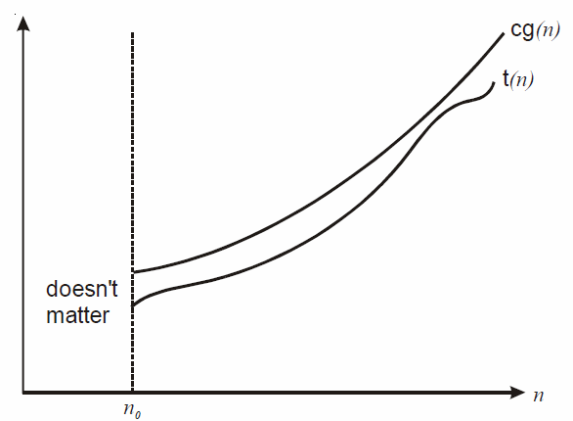
Big-Oh Notation (O)

Slide 99
Big-Oh Notation (O)
1 < log n < √n < n < n logn < n² < n³ < ……………< 2^{n} < 3^{n} < …. <n^{n}
Let t(n) = 2n + 3 upper bound
2n + 3 ≤ _____??
2n + 3 ≤ 5n n ≥ 1
here c = 5 and g(n) = n
t(n) = O(n)
2n + 3 ≤ 5n² n ≥ 1
here c = 5 and g(n) = n²
t(n) = O(n² )

Slide 100
Big-Omega notation (Ω)
This notation is used to describe the best case running time of algorithms and concerned with large values of n.
Definition: A function t(n) is said to be in Ω(g(n)), denoted as t(n) ϵ Ω(g(n)), if t(n) is bounded below by some positive constant multiple of g(n) for all large n. i.e., there exist some positive constant c and some non-negative integer n0. Such that
t(n) ≥cg(n) for all n ≥ n0
It represents the lower bound of the resources required to solve a problem.

Slide 101
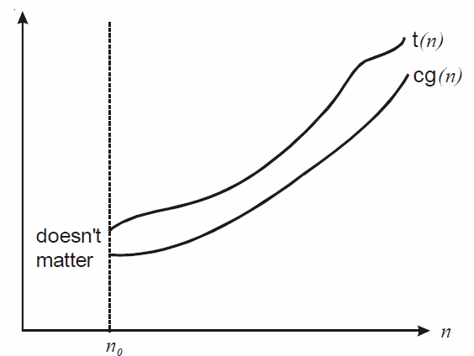
Big-Omega notation (Ω)

Slide 102
Big-Omega notation (Ω)
1 < log n < √n < n < n logn < n² < n³ < ……………< 2^{n} < 3^{n} < …. <n^{n}
Let t(n) = 2n + 3 lower bound
2n + 3 ≥ _____??
2n + 3 ≥ 1n n ≥ 1
here c = 1 and g(n) = n
t(n) = Ω(n)
2n + 3 ≥ 1log n n ≥ 1
here c = 1 and g(n) = log n
t(n) = Ω(log n)

Slide 103
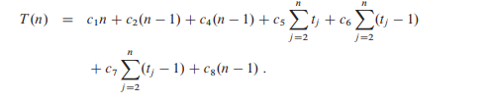

Asymptotic Analysis of Insertion sort
Time Complexity:
Best Case: the best case occurs if the array is already sorted, tj=1 for j=2,3…n.
Linear running time: O(n)

Slide 104
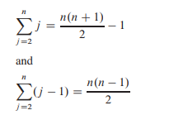
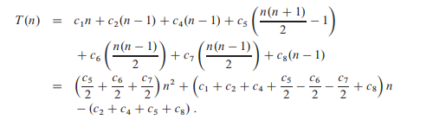
Asymptotic Analysis of Insertion sort
Worst case : If the array is in reverse sorted order
Quadratic Running time. O(n2)

Slide 105
Properties of O, Ω and θ
General property:
If t(n) is O(g(n)) then a * t(n) is O(g(n)). Similar for Ω and θ
Transitive Property :
If f (n) ϵ O(g(n)) and g(n) ϵ O(h(n)), then f (n) ϵ O(h(n)); that is O is transitive. Also Ω, θ, o and ω are transitive.
Reflexive Property
If f(n) is given then f(n) is O(f(n))
Symmetric Property
If f(n) is θ(g(n)) then g(n) is θ(f(n))
Transpose Property
If f(n) = O(g(n)) then g(n) is Ω(f(n))

Slide 106
Review Questions
Indicate constant time complexity in terms of Big-O notation.
A. O(n)
B. O(1)
C. O(logn)
D. O(n^2)
Big oh notation is used to describe __________
Big O Notation is a _________function used in computer science to describe an ____________
Big Omega notation (Ω) provides _________bound.
Given T1(n) =O(f(n)) and T2(n)=O(g(n).Find T1(n).T2(n)

Slide 107
ASYMPTOTIC NOTATION-THETA MATHEMATICAL FUNCTIONS

Slide 108
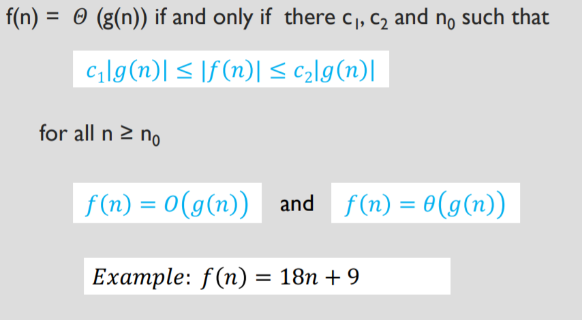
Asymptotic Notation – THETA Θ

Slide 109
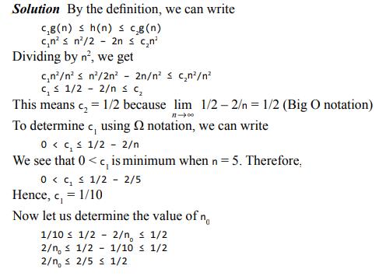
Example - THETA
Show that n2 /2 – 2n = Θ(n2 ).

Slide 110
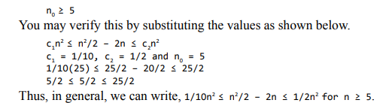
Example - THETA

Slide 111
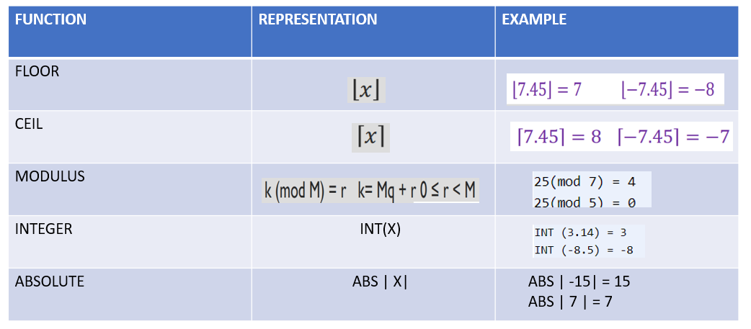
Mathematical Functions

Slide 112
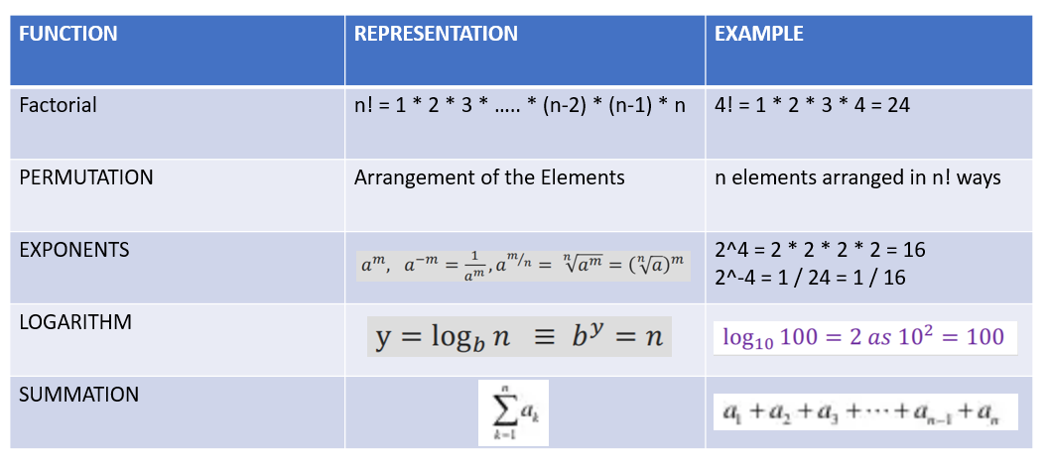
Mathematical Functions (Cont..)

Slide 113
Review Questions
Give examples of functions that are in Θ notation as well as functions that are not in Θ notation.
Which function gives the positive value of the given input?
K (mod) M gives the reminder of ____ divided by ____
For a given set of number n, the number of possible permutation will be equal to the ____________ value of n.
________Notation is used to specify both the lower bound and upper bound of the function.

Slide 114
DATA STRUCTURES AND ITS TYPES

Slide 115
Data Structure
A data structure is basically a group of data elements that are put together under one name
Defines a particular way of storing and organizing data in a computer so that it can be used efficiently
Data Structures are used in
Compiler design
Operating system
Statistical analysis package
DBMS
The selection of an appropriate data structure provides the most efficient solution

Slide 116
Terms in Data Structure
Data: Data can be defined as an elementary value or the collection of values, for example, student's name and its id are the data about the student.
Group Items: Data items which have subordinate data items are called Group item, for example, name of a student can have first name and the last name.
Record: Record can be defined as the collection of various data items, for example, if we talk about the student entity, then its name, address, course and marks can be grouped together to form the record for the student.
File: A File is a collection of various records of one type of entity, for example, if there are 60 employees in the class, then there will be 20 records in the related file where each record contains the data about each employee.
Attribute and Entity: An entity represents the class of certain objects. it contains various attributes. Each attribute represents the particular property of that entity.
Field: Field is a single elementary unit of information representing the attribute of an entity.

Slide 117

Types in Data Structure

Slide 118
Types of Data Structure
Primitive Data Structures:
Primitive data structures are the fundamental data types which are supported by a programming language. Some basic data types are
Integer
Real
Character
Boolean
Non-Primitive Data Structures:
Non-primitive data structures are those data structures which are created using primitive data structures. Examples of such data structures include
linked lists
stacks
trees
graphs

Slide 119
LINEAR AND NON-LINEAR DATA STRUCTURES

Slide 120

Types of Data Structure – Non Primitive Linear
Arrays
An array is a collection of similar type of data items and each data item is called an element of the array.
Linked List
Dynamic data structure in which elements (called nodes) form a sequential list

Slide 121


Types of Data Structure – Non Primitive Linear
Stack
Linear data structure in which insertion and deletion of elements are done at only one end, which is known as the top of the stack
Queue
Linear data structure in which the element that is inserted first is the first one to be taken out

Slide 122
Types of Data Structure – Non Primitive - Non Linear
The data structure where data items are not organized sequentially is called non linear data structure
Types
Trees
Graphs

Slide 123

Types of Data Structure – Non Primitive - Non Linear
TREES
A tree is a non-linear data structure which consists of a collection of nodes arranged in a hierarchical order.
One of the nodes is designated as the root node, and the remaining nodes can be partitioned into disjoint sets such that each set is a sub-tree of the root.

Slide 124

Types of Data Structure – Non Primitive - Non Linear
GRAPHS
A graph is a non-linear data structure which is a collection of vertices (also called nodes) and edges that connect these vertices.
A graph is often viewed as a generalization of the tree structure.
every node in the graph can be connected with another node in the graph.
When two nodes are connected via an edge, the two nodes are known as neighbours.

Slide 125
Review Questions
Compare a linked list with an array.
Is Array static structure or dynamic structure (TRUE / FALSE)
The data structure used in hierarchical data model is _________
In a stack, insertion is done at __________
Which Data Structure follows the LIFO fashion of working?
The position in a queue from which an element is deleted is called as __________

Slide 126
POINTER

Slide 127
Definition and Features of Pointer
Definition:
Pointer is a variable that stores the address of another variable.
Features
Pointer saves the memory space.
Execution time of pointer is faster because of direct access to the memory location.
With the help of pointers, the memory is accessed efficiently, i.e., memory is allocated and deallocated dynamically.
Pointers are used with data structures.

Slide 128
Pointer declaration, initialization and accessing
Consider the following statement
int q = 159;
In memory, the variable can be represented as follows −
q
Variable
159
Value
1000
Address

Slide 129
Pointer declaration, initialization and accessing(Cont..)
Declaring a pointer
It means ‘p’ is a pointer variable which holds the address of another integer variable, as mentioned in the statement below −
int *p;
Initialization of a pointer
Address operator (&) is used to initialise a pointer variable.
For example −
int q = 159;
int *p;
p= &q;
Variable
Value
Address
q
159
1000
p
2000
1000

Slide 130
Pointer declaration, initialization and accessing(Cont..)
Accessing a variable through its pointer
To access the value of a variable, indirection operator (*) is used.
For example −
int q=159, *p,n;
p=&q;
n=*p Here, ‘*’ can be treated as value at address.
p = &q;
n = *p; n =q

Slide 131
1D INITIALIZATION & ACCESSING USING POINTERS

Slide 132
Pointers and one-dimensional arrays
The compiler allocates Continuous memory locations for all the elements of the array.
The base address = first element address (index 0) of the array.
Syntax: data_type (var_name)[size_of_array]
For Example − int a [5] = {10, 20,30,40,50};
Elements
The five elements are stored as follows −
//Declaration
int *p;
int my_arr[] = {11, 22, 33, 44, 55};
p = my_arr;
Elements | a[0] | a[1] | a[2] | a[3] | a[4]
Values | 10 | 20 | 30 | 40 | 50
Address | 1000 | 1004 | 1008 | 1012 | 1016
Base Address
a=&a[0]=1000

Slide 133
Pointers and one-dimensional arrays (Cont)
If ‘p’ is declared as integer pointer, then, an array ‘a’ can be pointed by the following assignment −
p = a; (or) p = &a[0];
Every value of 'a' is accessed by using p++ to move from one element to another element. When a pointer is incremented, its value is increased by the size of the data type that it points to. This length is called the "scale factor".
The relationship between ‘p’ and 'a' is explained below
P = &a[0] = 1000
P+1 = &a[1] = 1004
P+2 = &a[2] = 1008
P+3 = &a[3] = 1012
P+4 = &a[4] = 1016

Slide 134
Pointers and one-dimensional arrays (Cont..)
Address of an element is calculated using its index and the scale factor of the data type. An example to explain this is given herewith.
Address of a[3] = base address + (3* scale factor of int)
= 1000 + (3*4)
= 1000 +12
= 1012
Pointers can be used to access array elements instead of using array indexing.
*(p+3) gives the value of a[3].
a[i] = *(p+i)

Slide 135
Example Program
Following is the C program for pointers and one-dimensional arrays −
#include<stdio.h> main ( )
{
int a[5];
int *p,i;
printf ("Enter 5 lements");
for (i=0; i<5; i++)
scanf ("%d", &a[i]);
p = &a[0];
printf ("Elements of the array are");
for (i=0; i<5; i++)
printf("%d", *(p+i));
}
Output
When the above program is executed, it produces the following result −
Enter 5 elements : 10 20 30 40 50
Elements of the array are : 10 20 30 40 50

Slide 136
Example Program
POINTER ARRAYS
Syntax: data_type (*var_name)[size_of_array]
Example:
int (*arr_ptr)[5], *a_ptr, arr[5][5] ={{10,20,30,23,12}, {15,25,35,33,88},
{45,25,77,57,54}, {65,34,67,33,99}, {44,45,55,44,65}};
arr_ptr= & arr;
a_ptr= & arr;
arr_ptr++;
a_ptr++;
1020 10 | 1024 20 | 1028 30 | 1032 23 | 1036 12
1040 15 | 1044 25 | 1048 35 | 1052 33 | 1056 88
1060 45 | 1064 25 | 1068 77 | 1072 57 | 1076 54
1080 65 | 1084 34 | 1088 67 | 1092 33 | 1096 99
1100 44 | 1104 45 | 1108 55 | 1112 44 | 1116 65
arr_ptr
a_ptr

Slide 137
Example Program : 1D array using Pointer
#include<stdio.h>
int main()
{
int array[5];
int i,sum=0;
int *ptr;
printf("\nEnter array elements (5 integer values):");
for(i=0;i<5;i++)
scanf("%d",&array[i]);
/* array is equal to base address * array = &array[0] */
ptr = array; for(i=0;i<5;i++)
{
//*ptr refers to the value at addresssum = sum + *ptr;
ptr++;
}
printf("\nThe sum is: %d",sum);
}
Output
Enter array elements (5 integer values): 1 2 3 4 5
The sum is: 15

Slide 138
2D INITIALIZATION & ACCESSING USING POINTERS

Slide 139
Pointers and two-dimensional arrays
Memory allocation for a two-dimensional array is as follows −
int a[3] [3] = {1,2,3,4,5,6,7,8,9};
0
1
2
0
1 | 2 | 3
4 | 5 | 6
7 | 8 | 9
1
Base Address=1000=&a[0][0]
2
a[0][0]
a[0][1]
a[0][2]
Row 1->
1 | 2 | 3
1000
1004
1008
a[1][0]
a[1][1]
a[1][2]
Row 2->
4 | 5 | 6
1012
1016
1020
a[2][0]
a[2][1]
a[2][2]
Row 1->
7 | 8 | 9
1024
1028
1032

Slide 140
Pointers and two-dimensional arrays
Assigning Base Address to pointer
int *p
p=&a[0][0] (or)
p=a
Pointer is used to access the elements of 2-dimensional array as follows
a[i][j]=*(p+j *columnsize+j)
a[1] [2] = *(1000 + 1*3+2)
= *(1000 + 3+2)
= *(1000 + 5*4) // 4 is Scale factor
= * (1000+20)
= *(1020)
a[1] [2] = 6

Slide 141
Example Program
#include<stdio.h> main ( )
{ int a[3] [3], i,j;
int *p;
clrscr ( );
printf ("Enter elements of 2D array");
for (i=0; i<3; i++)
{
for (j=0; j<3; j++)
{
scanf ("%d", &a[i] [j]);
}
}
p = &a[0] [0];
printf ("elements of 2d array are");
for (i=0; i<3; i++)
{
for (j=0; j<3; j++)
{
printf ("%d \t", *(p+i*3+j));
}
printf ("\n");
}
getch ( );
}
Output
When the above program is executed, it produces the following result −
enter elements of 2D array 1 2 3 4 5 6 7 8 9
Elements of 2D array are
1 2 3
4 5 6
7 8 9

Slide 142
Review Questions
Let’s consider 60 students took this course. Each student is supposed to give a rating 1, 2, 3 4 or 5; one being bad and 5 being good. Find the ratings are spread count the number of times each rating was given.
Write a Program in C for the following Array operations
a. Creating an Array of N Integer Elements
b. Display of Array Elements with Suitable Headings
c. Inserting an Element (ELEM) at a given valid Position (POS)
d. Deleting an Element at a given valid Position(POS)
e. Exit.
Support the program with functions for each of the above operations.

Slide 143
DECLARING STRUCTURE AND ACCESSING

Slide 144
Definition of Structures
Structures are user defined data types
It is a collection of heterogeneous data
It can have integer, float, double or character data in it
We can also have array of structures
struct<<structname>>
{
members;
}element;
We can access element.members;

Slide 145
Declaration of Structures
Syntax:
struct struct_Name
{
<data-type> member_name;
<data-type> member_name;
…
} list of variables;
Example: Structure to hold student details struct Student
{
int regNo; char name[25];
int english, science, maths;
} stud;

Slide 146
Declaration of Structures
Syntax:
struct struct_Name
{
<data-type> member_name;
<data-type> member_name;
…
};
struct struct_Name struct_var;
struct Student
{
int regNo; char name[25];
int english, science, maths;
};
struct Student stud;

Slide 147
Declaration of Structures
//Static Initialization of stud
stud.regNo=1425; strcpy(stud.name,“Banu”); stud.English=78; stud.science=89; stud.maths=56;
//Dynamic Initialization of stud
scanf(“%d %s %d %d %d”,&stud.regNo, stud.name, &stud.English,&stud.science, &stud.maths);

Slide 148
Accessing and Updating Structures
struct Student
{
int regNo; char name[25];
int english, science, maths;
};
struct Student stud;
scanf(“%d %s %d %d %d”,&stud.regNo, stud.name, &stud.english,&stud.science, &stud.maths);
printf("Register number =% d\n",stud.Regno); printf("Name %s",stud.name);
stud.english= stud.english +10; stud.science++;
//Accessing member Regno
//Accessing member name
//Updating member english
//Updating member science

Slide 149
Nested Structures
struct Student
{
int regNo; char name[25];
struct marks
{ int english, science, maths; }
struct Student
{
int regNo; char name[25];
struct m marks;
} Amar;
struct m
{
int english; int science;
int maths;
};
} Amar;
Amar.regNo; Amar.marks.english; Amar.marks.science; Amar.marks.maths;
struct Student
{
int regNo; char name[25];
struct {int english, science, maths } marks;
} Amar;

Slide 150
Example Program
#include <stdio.h>
#include <string.h>
struct Books
{
char title[50];
char author[50];
char subject[100];
int book_id;
};
int main( )
{
struct Books Book1; /* Declare Book1 of type Book */
struct Books Book2; /* Declare Book2 of type Book */
/* book 1 specification */ strcpy( Book1.title, "C Programming"); strcpy( Book1.author, "Nuha Ali"); strcpy( Book1.subject, "C Programming Tutorial"); Book1.book_id = 6495407

Slide 151
Example Program
/* book 2 specification */ strcpy( Book2.title, "Telecom Billing"); strcpy( Book2.author, "Zara Ali"); strcpy( Book2.subject, "Telecom Billing Tutorial"); Book2.book_id = 6495700;
/* print Book1 info */
printf( "Book 1 title : %s\n", Book1.title);
printf( "Book 1 author : %s\n", Book1.author);
printf( "Book 1 subject : %s\n", Book1.subject);
printf( "Book 1 book_id : %d\n", Book1.book_id);
/* print Book2 info */
printf( "Book 2 title : %s\n", Book2.title);
printf( "Book 2 author : %s\n", Book2.author);
printf( "Book 2 subject : %s\n", Book2.subject);
printf( "Book 2 book_id : %d\n", Book2.book_id);
return 0;
}
OUTPUT
Book 1 title : C Programming
Book 1 author : Nuha Ali
Book 1 subject : C Programming Tutorial
Book 1 book_id : 6495407
Book 2 title : Telecom Billing
Book 2 author : Zara Ali
Book 2 subject : Telecom Billing Tutorial
Book 2 book_id : 6495700

Slide 152
Example Program
#include<stdio.h>
struct student
{
char name[20];
int id;
float marks;
};
void main()
{
struct student s1,s2,s3;
int dummy;
printf("Enter the name, id, and marks of student 1 ");
scanf("%s %d %f",s1.name,&s1.id,&s1.marks);
scanf("%c",&dummy);
printf("Enter the name, id, and marks of student 2 ");
scanf("%s %d %f",s2.name,&s2.id,&s2.marks);
scanf("%c",&dummy);
printf("Enter the name, id, and marks of student 3 ");
scanf("%s %d %f",s3.name,&s3.id,&s3.marks);
scanf("%c",&dummy);
printf("Printing the details....\n");
printf("%s %d %f\n",s1.name,s1.id,s1.marks);
printf("%s %d %f\n",s2.name,s2.id,s2.marks);
printf("%s %d %f\n",s3.name,s3.id,s3.marks);
}

Slide 153
Example Program
Output
Enter the name, id, and marks of student 1
James
90
90
Enter the name, id, and marks of student 2
Adoms
90
90
Enter the name, id, and marks of student 3
Nick
90
90
Printing the details....
James 90 90.000000
Adoms 90 90.000000
Nick 90 90.000000

Slide 154
DECLARING ARRAY OF STRUCTURES AND ACCESSING

Slide 155
Array of Structures
struct Student
{
int regNo; char name[25];
int english, science, maths;
};
struct Student stud[10];
scanf(“%d%s%d%d%d”,&stud[1].regNo,stud[1].name,&stud[1].english,&stud[1].science,
&stud[1].maths);
printf("Register number = %d\n",stud[1].Regno); printf("Name %s",stud[1].name); stud.[1]english= stud[0].english +10; stud[1].science++;
//Accessing member Regno
//Accessing member name
//Updating member english
//Updating member science

Slide 156
Example Program
#include<stdio.h>
#include <string.h>
struct student{
int rollno;
char name[10];
};
int main()
{
int i;
struct student st[5];
printf("Enter Records of 5 students");
for(i=0;i<5;i++){
printf("\nEnter Rollno:");
scanf("%d",&st[i].rollno);
printf("\nEnter Name:");
scanf("%s",&st[i].name);
}
printf("\nStudent Information List:");
for(i=0;i<5;i++){
printf("\nRollno:%d, Name:%s",st[i].rollno,st[i].name);
}
return 0;
}

Slide 157
Example Program
OUTPUT
Enter Records of 5 students Enter Rollno:1 Enter Name:Sonoo Enter Rollno:2 Enter Name:Ratan Enter Rollno:3 Enter Name:Vimal Enter Rollno:4 Enter Name:James Enter Rollno:5 Enter Name:Sarfraz Student Information List: Rollno:1, Name:Sonoo Rollno:2, Name:Ratan Rollno:3, Name:Vimal Rollno:4, Name:James Rollno:5, Name:Sarfraz

Slide 158
Review Questions
Write a C program for student mark sheet using structure
Write a C program using structure to find students grades in a class
Write a C program for book details using structure
Calculating the area of a rectangle using structures in C language.

